Slide 1

CARA
Presented by
Satvik Bhardwaj
2111981315

Slide 2
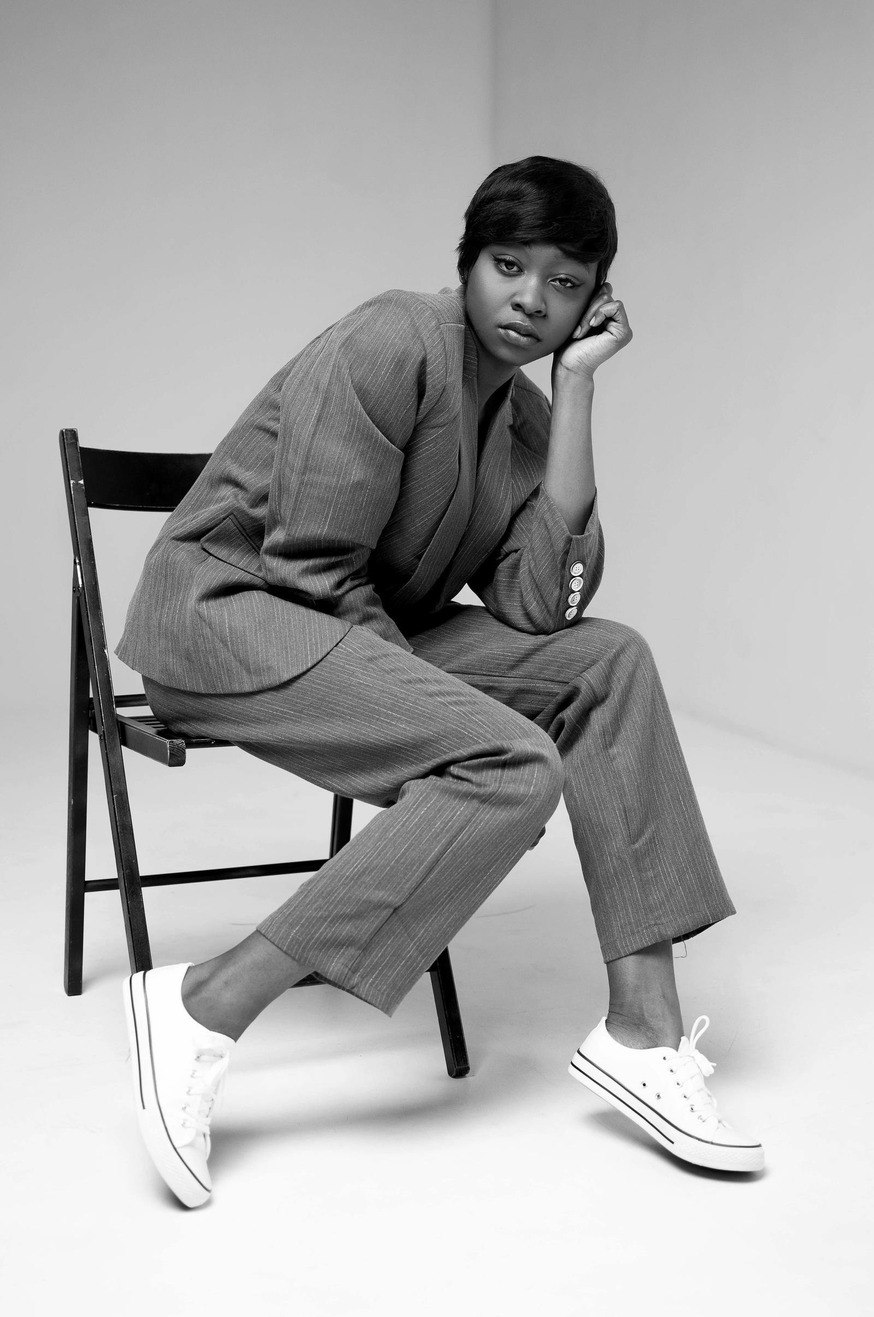

IDEA
CREATING A USER-FRIENDLY WEBSITE
SIMPLIFIES ONLINE SHOPPING.
SEAMLESS, ENGAGING, AND VISUALLY APPEALING PLATFORM
USERS COULD BROWSE, SELECT, AND PURCHASE PRODUCTS WITH EASE

Slide 3


CONCEPT
DELIVERING A RESPONSIVE, VISUALLY ATTRACTIVE, AND INTUITIVE USER INTERFACE
CRAFTING A SLEEK DESIGN
OPTIMIZING FOR MOBILE AND DESKTOP DEVICES
ENSURING SMOOTH NAVIGATION

Slide 4

APPLICATIONS
Designing Product Listing
User-friendly shopping cart
Animation for good UI.
Responsive across various different devices

Slide 5

Thank you!

